Slide 1


DESIGN 1
Lesson 2: Guided Practice: Sizing & Attributes
Ms. Abboud • Grade 9 - Design 1 • Term 1, Week 6

Slide 2
Learning Objectives
WALT - We Are Learning To
WILF - What I'm Looking For
Control image size and placement using width and height.
Fix common broken-image errors, with teacher support.
Both images are a reasonable size for the page.
Both images have accurate alt text and working paths.

Slide 3
Academic Vocabulary
File Path
The route the browser follows to find a file, like images/profile.jpg - the folder name(s) plus the filename.

Slide 4
Frayer Model: File Path
DEFINITION
CHARACTERISTICS
The route the browser follows to find a file, like images/profile.jpg - the folder name(s) plus the filename.
The route to a file; includes folder names and filename.
FILE PATH
EXAMPLES
NON-EXAMPLES
images/profile.jpg.
A URL to a totally different website.

Slide 5
National Identity Integration
UAE Landmarks and Tourism: a tourism site's photos must load quickly and display correctly, sized appropriately for every visitor, on every device.

Slide 6
STARTER
What's Wrong Here?
An image is showing way too large for the page.
What's wrong, and how would you fix it?
Hook • Engage & Ask
5 - 10 minutes

Slide 7
LESSON CORE
I Do: Width & Height
Teacher models adding width and height to resize an oversized image.
Keep the same ratio in both, so the picture doesn't stretch or squash.
Gradual Release of Responsibility
30 - 40 minutes
Example: a sized image
<img src="images/profile.jpg" alt="A photo of me smiling outdoors"
width="300" height="300">
1 / 3

Slide 8
LESSON CORE
We Do: Checkpoints
Checkpoint 1: resize the homepage image to a reasonable size.
Checkpoint 2: add a second image elsewhere with correct attributes.
Common error check: broken paths - wrong folder, wrong extension, wrong capitals.
Gradual Release of Responsibility
30 - 40 minutes
2 / 3

Slide 9
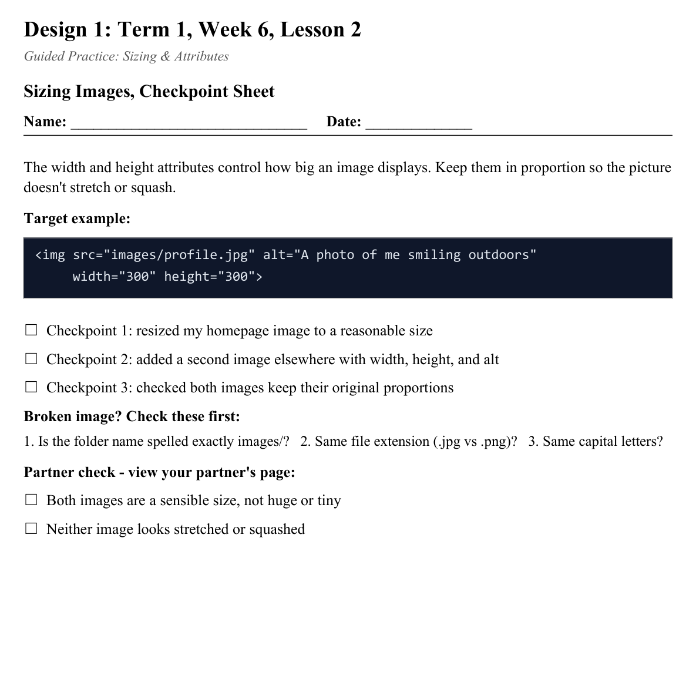
LESSON CORE
You Do: Resize & Add
Resize your existing image, then add a second correctly-sized, correctly-described image.
Activity: Sizing Images, Checkpoint Sheet
Gradual Release of Responsibility
30 - 40 minutes
3 / 3

Slide 10
CLOSURE
Screenshot Check
Does the page look intentional, not broken or oversized?
Transition & Extend
5 - 10 minutes

